Slide 1

CSCI 4307 Project
AI Optimization in IT Office

Slide 2
Duties of an IT Office
Managing company devices (inventory)
Ensuring data security
Maintaining a ticketing system for inquiries
Working with departments
Handling computer purchases and deployment

Slide 3
The focus
Many IT Professionals follow a structured process for purchasing and deploying computers for use by the organization.
The basic process includes:
Receiving information from the client (other members of the company)
Device quote and purchase request
Adding the device to Inventory
Applying company policies for compliance and management

Slide 4
Problem
The time complexity of processing a new device takes in several factors.
Corresponding with the client through the ticket request
Compiling accurate data for inventory entry or entries
Preparing the new device for deployment
The goal of this project is to use AI Optimization to read through ticket and create an inventory entry or entries for the database.
By saving a few minutes of manual data collecting and entry here and there, the office will accumulate hours of regained time.

Slide 5
How did I do it?
Optimization techniques research
Natural Language Processing (spaCy)
Python
Pandas and openpyxl for Excel read and write
Parser text tool for emails from Python
Meta AI for dataset creation*

Slide 6
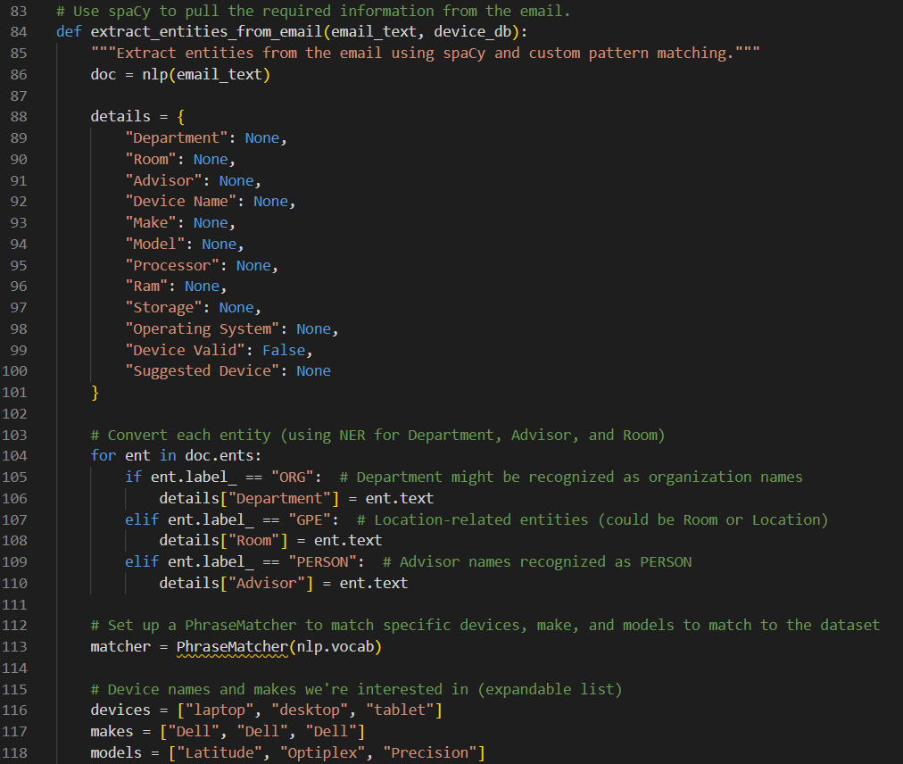
Demo
To run the code:
Install spaCy and set it up (in the readme)
Update the file paths for the excel inventory sheet and database file.
Files:
optimizeScript.py
optimize_config.py
devicelist.txt
Inventory.xlsx

Slide 7
RESOURCES
Back
For email dataset creation:
Meta AI (2024, November 3). Email request generation [Computer software]. Unpublished.
Text processing:
spaCy (2024, November 23). https://spacy.io/
Research:
Abdolrasol, M. G. M., Hussain, S. M. S., Ustun, T. S., Sarker, M. R., Hannan, M. A., Mohamed, R., Ali, J. A., Mekhilef, S., & Milad, A. (2024, November 3) (2021). Artificial Neural Networks Based Optimization Techniques: A Review. Electronics, 10(21), 2689. <https://doi.org/10.3390/electronics10212689>
Bian, K., Priyadarshi, R. (2024, November 3) Machine Learning Optimization Techniques: A Survey, Classification, Challenges, and Future Research Issues. Arch Computation Methods Eng 31, 4209–4233. https://doi.org/10.1007/s11831-024-10110-w

Slide 8
Questions?

